Slide 1
COVID-19 India: Understand Your Neighbourhood

Slide 2
Project Overview
Project gives an overview of COVID-19 cases in entire India till date. The number of confirmed cases, number of cured people and number of deaths due to COVID-19. Also, the information backtracks to March-2020, since the time there was sudden rise in cases. Maps are shown to highlight all the cases across India and sub level to states and to districts too.

Slide 3
Methodology
In this project, many libraries are being used for different purposes, some of them are - pandas, numpy, requests, matplotlib, sklearn, scipy, bs4 and folium. Each helps to attain certain functionality in the project.
"bs4" is used for website scraping.
"requests" to send and receive response to website. Also is used to send request to download files from a website.
"geopy" is used to get geographical latitudes and longitudes of certain state/district.
"folium" is used to map all the related lat and lng for diff areas and popup label accordingly on the maps.
"K-Means Clustering" is used to cluster states/district on the basis of COVID-19 cases/cured/deaths in an area or on the basis of census data wherein factors like population, literacy rate, workers and non-workers, rural/urban households provide some insight on the rise of these cases in an area.

Slide 4
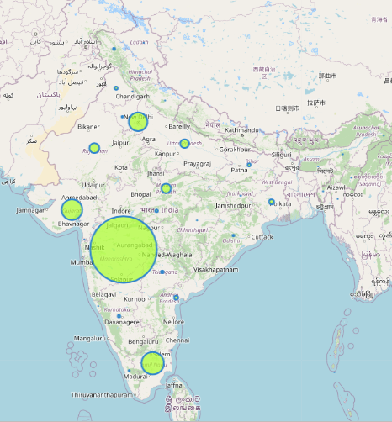
Map to show state-wise cases for COVID-19 in India (size of circle depicts the high count of cases)

Slide 5
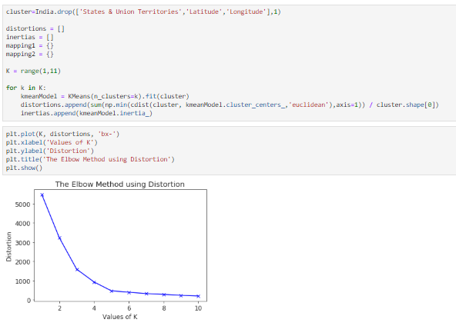
Number of clusters to be used in "K-Means" is based on elbow method, calculated using Euclidean distance.

Slide 6
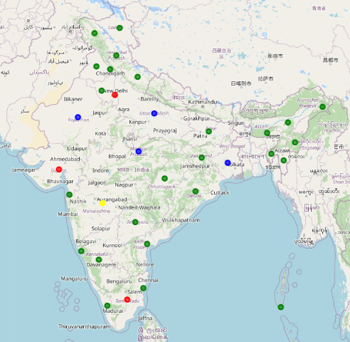
Map to show clusters of states of India on the basis of COVID-19 data

Slide 7
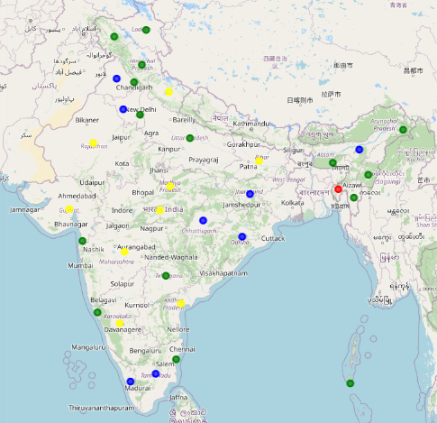
Map to show clusters of states of India on the basis of Census-2011 data

Slide 8
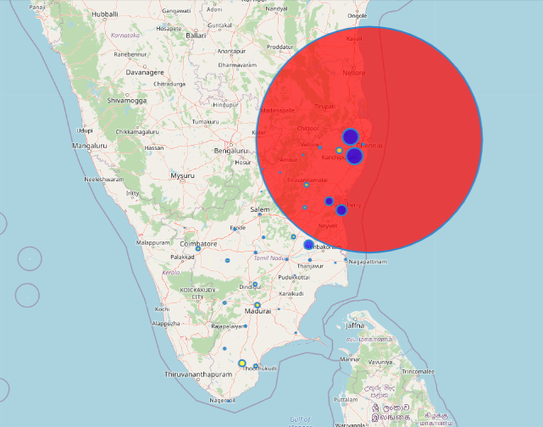
Map showing district level cases of COVID-19 for selected state (Each color represents different cluster)

Slide 9
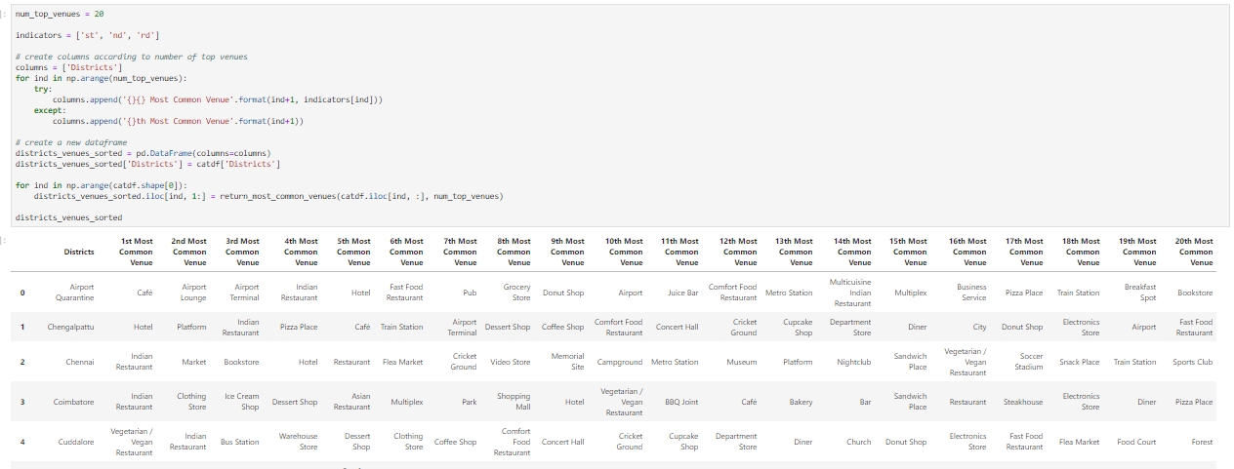
Listed below are the most common places within each district according to their category

Slide 10
Results
Project successfully cluster all the states on the basis of COVID-19 and census data. We can compare both the results and then make policies/actions/discussions to be implemented on a cluster as a whole within the country.
Also, users are able to visualize all the data, COVID-19 impact on states and districts and further all the venue in a state/district of their choice.

Slide 11
Discussion
This infers that project can cluster states/districts and then further provide data related to venues. We can now move forward in examining the impact of factors that were used in census data to know more about the rise in cases and more factors contributing to it.

Slide 12
Conclusion
This will surely help people to know about their neighbourhood and take precautionary measures. More work can be done by analysing the data and predict impact of COVID on certain cluster of states.

